Slide 1
BHAVANA
DAY 14
22/04/2024

Slide 2
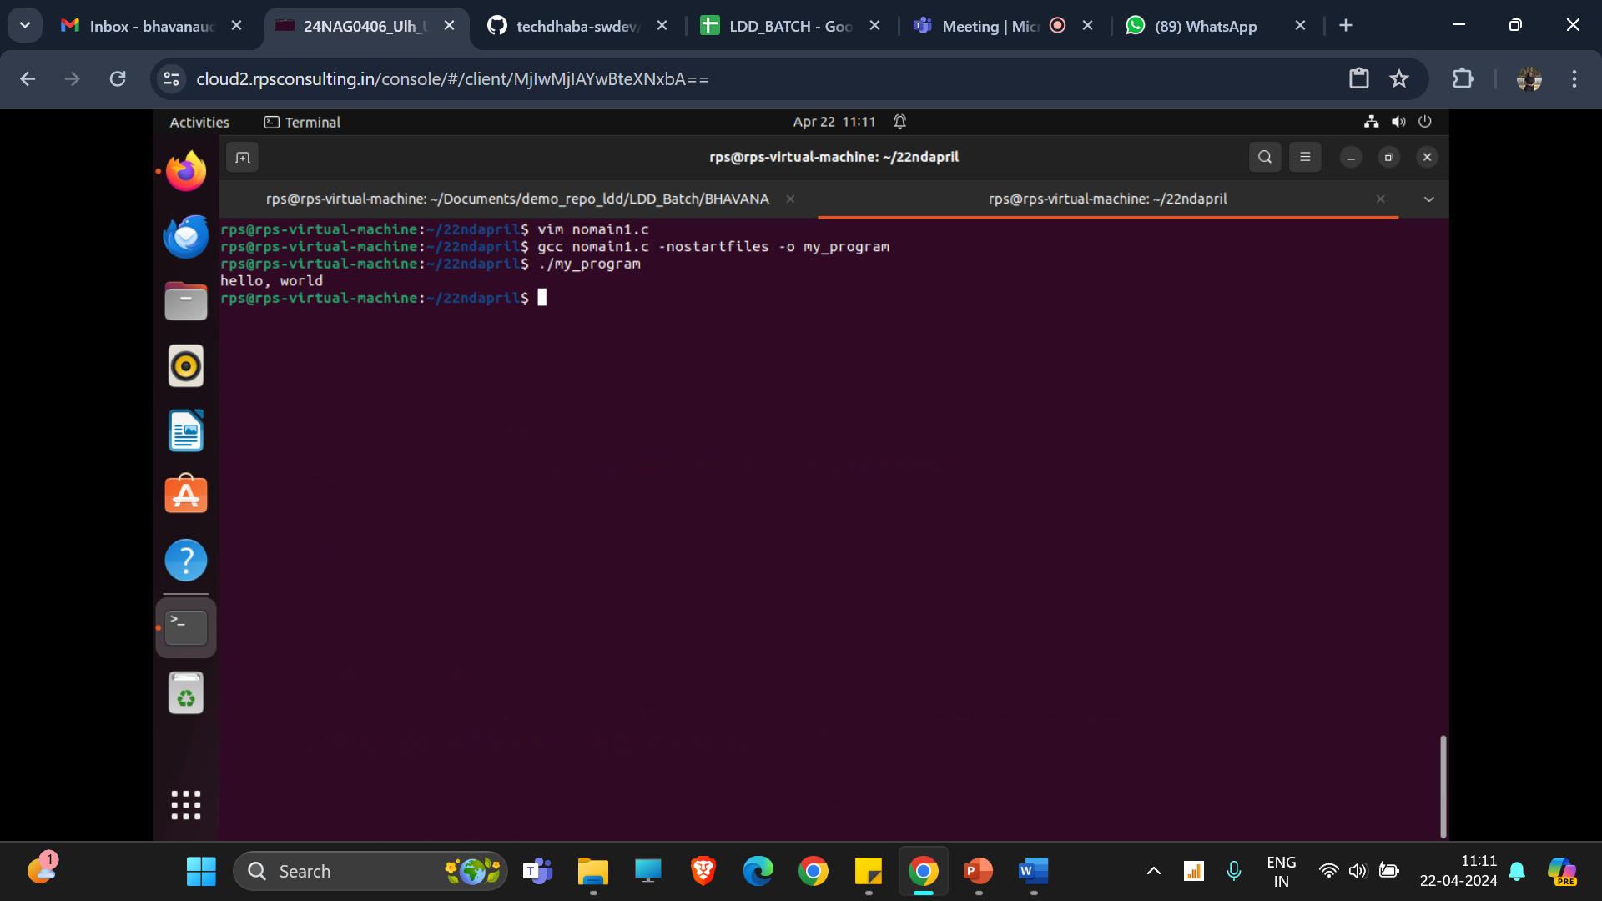
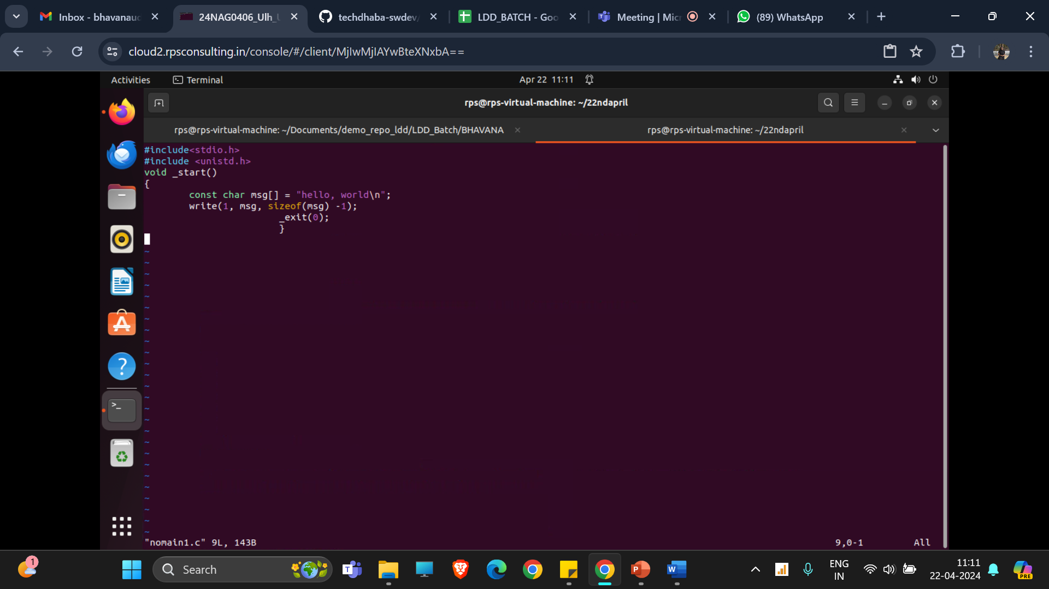
EXECUTING PROGRAM WITHOUT MAIN FUNCTION:

Slide 3
gcc -shared -fPIC -o libcalculator.so calculator.c
gcc main_calculator.c -o dynamic_calculator -ldl
This program dynamically loads a shared library named libcalculator.so, which contains implementations of basic arithmetic functions (add, subtract, multiply, divide). Once the library is successfully loaded, the program retrieves function pointers for each arithmetic operation from the library using dlsym.Then, the program performs arithmetic calculations using these dynamically loaded functions with sample arguments (10 and 5), and prints the results to the console.Finally, it closes the dynamically loaded library to release the associated resources. In summary, this program demonstrates dynamic loading of functions from a shared library and their usage for arithmetic calculations in a C program.

Slide 4


